Slide 1
WHY? We did it

Slide 2
TSR: Technologists social responsibility

Slide 3
Small step towards restoring the faith in a belief called !ndia
and let the world know
भारत आज भी गुरु है

Slide 4
Glorious past & diversity makes us The worlds tourist HUB

Slide 5
How big travel and tourism industry is in India?
According to World Travel and Tourism Council:
GDP: DIRECT CONTRIBUTION :
The direct contribution of Travel & Tourism to GDP was INR2,478.2bn (2.2% of total GDP) in 2014, and is forecast to rise by 7.6% in 2016.
EMPLOYMENT: DIRECT CONTRIBUTION :
In 2014 Travel & Tourism directly supported 230 Million jobs (5.5% of total employment).

Slide 6
The great opportunity is marred by:
Lack of awareness
Public apathy
Crime
Cheap non-responsible media portrayal

Slide 7
Getting the right people to do the job:
Two type of assistance a guide can give you.
1 Tour Guide :
Government Licenced Legitimate Tour guides giving you a tour of a place you are visiting. e.g. you go to a monument and you hire a guide.
2 Tour buddy :
giving you online/offline assistance to some city/place.
For e.g. What are the regional famous food, where to try these food, nice place to hang around. How do you commute in this city. All the precautions pros and cons of the places.

Slide 8

We Seek out the Govt. Approved Guides to play host to travellers.

Slide 9
Login up screen for ~ Tourist & Guide

Slide 10
Verification Screen for both Tourist or Guide.

Slide 11
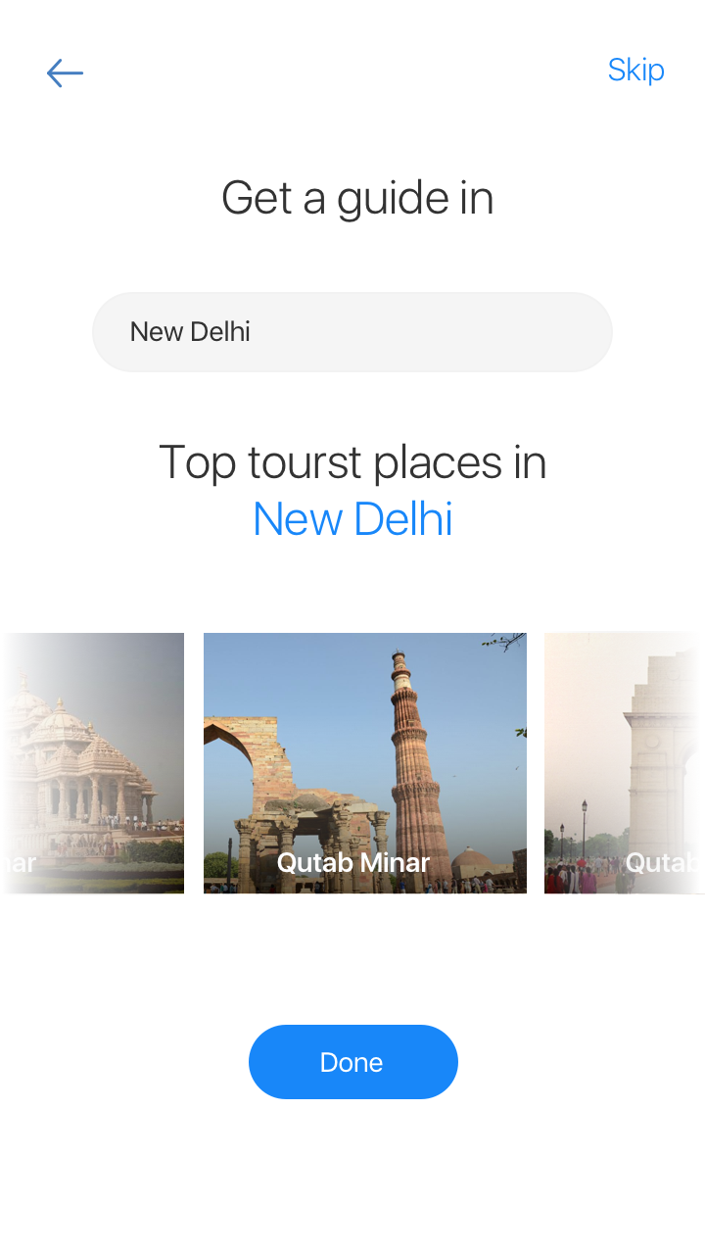
Get main attractions and top guides for the selected place

Slide 12
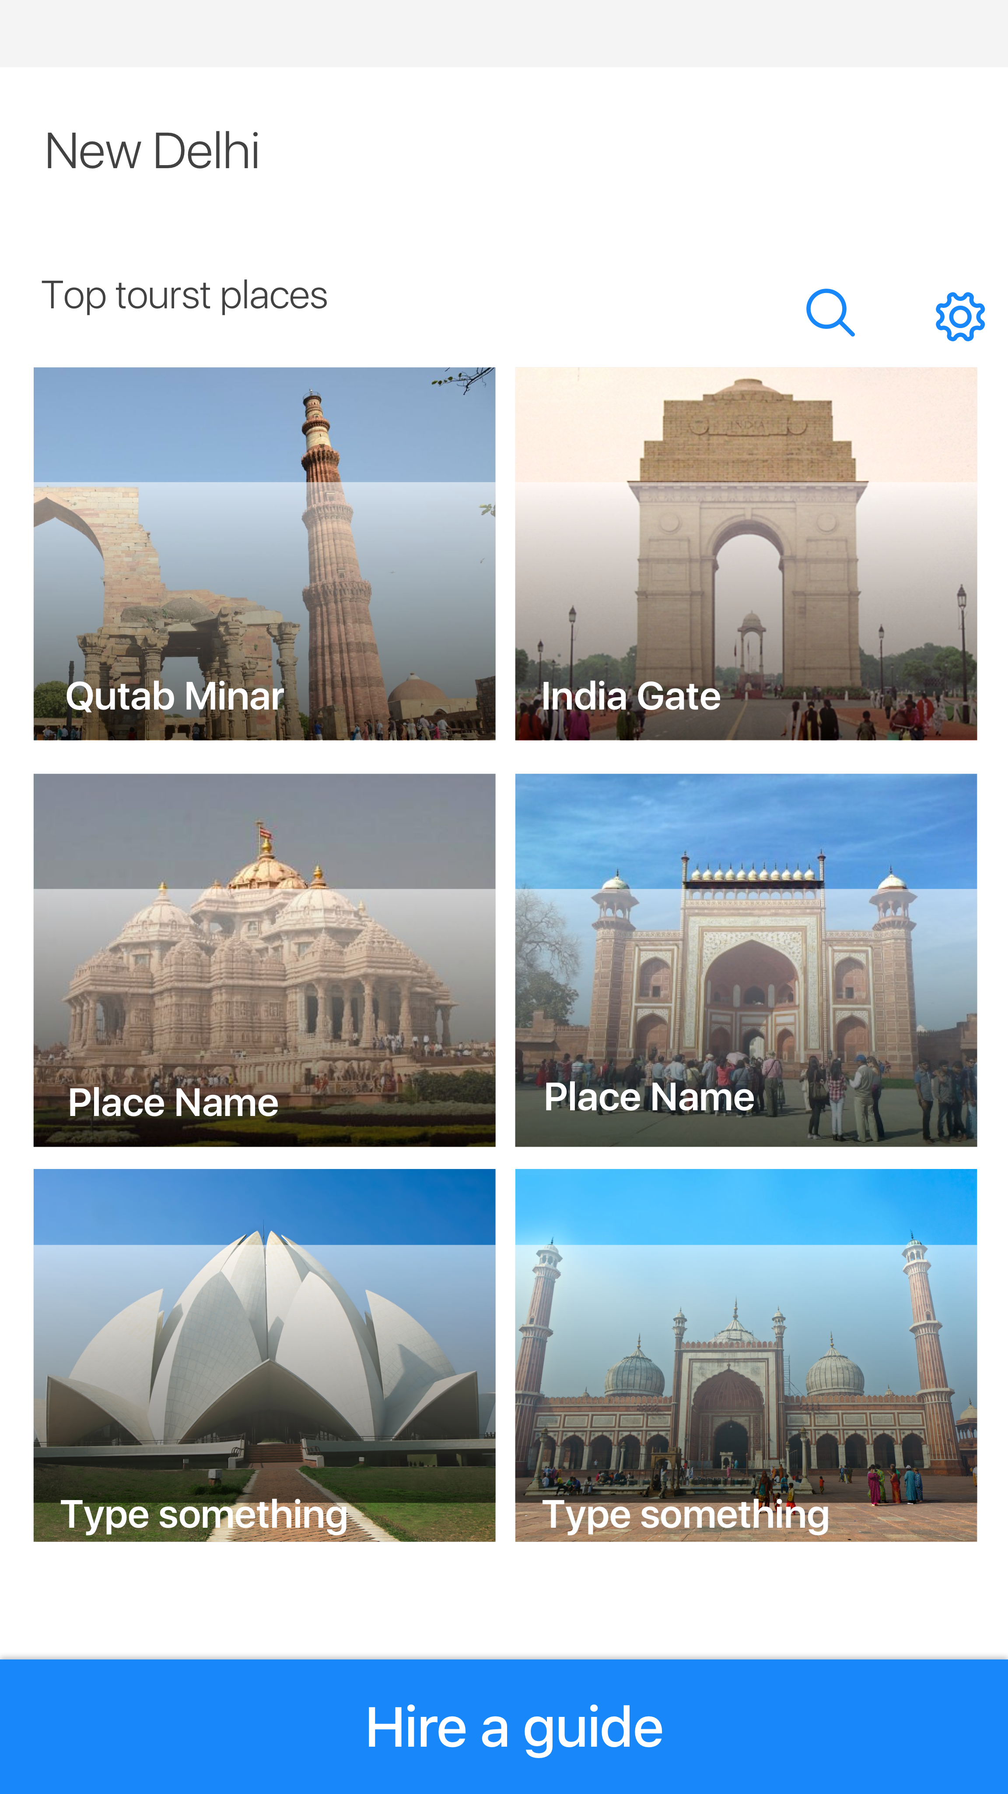
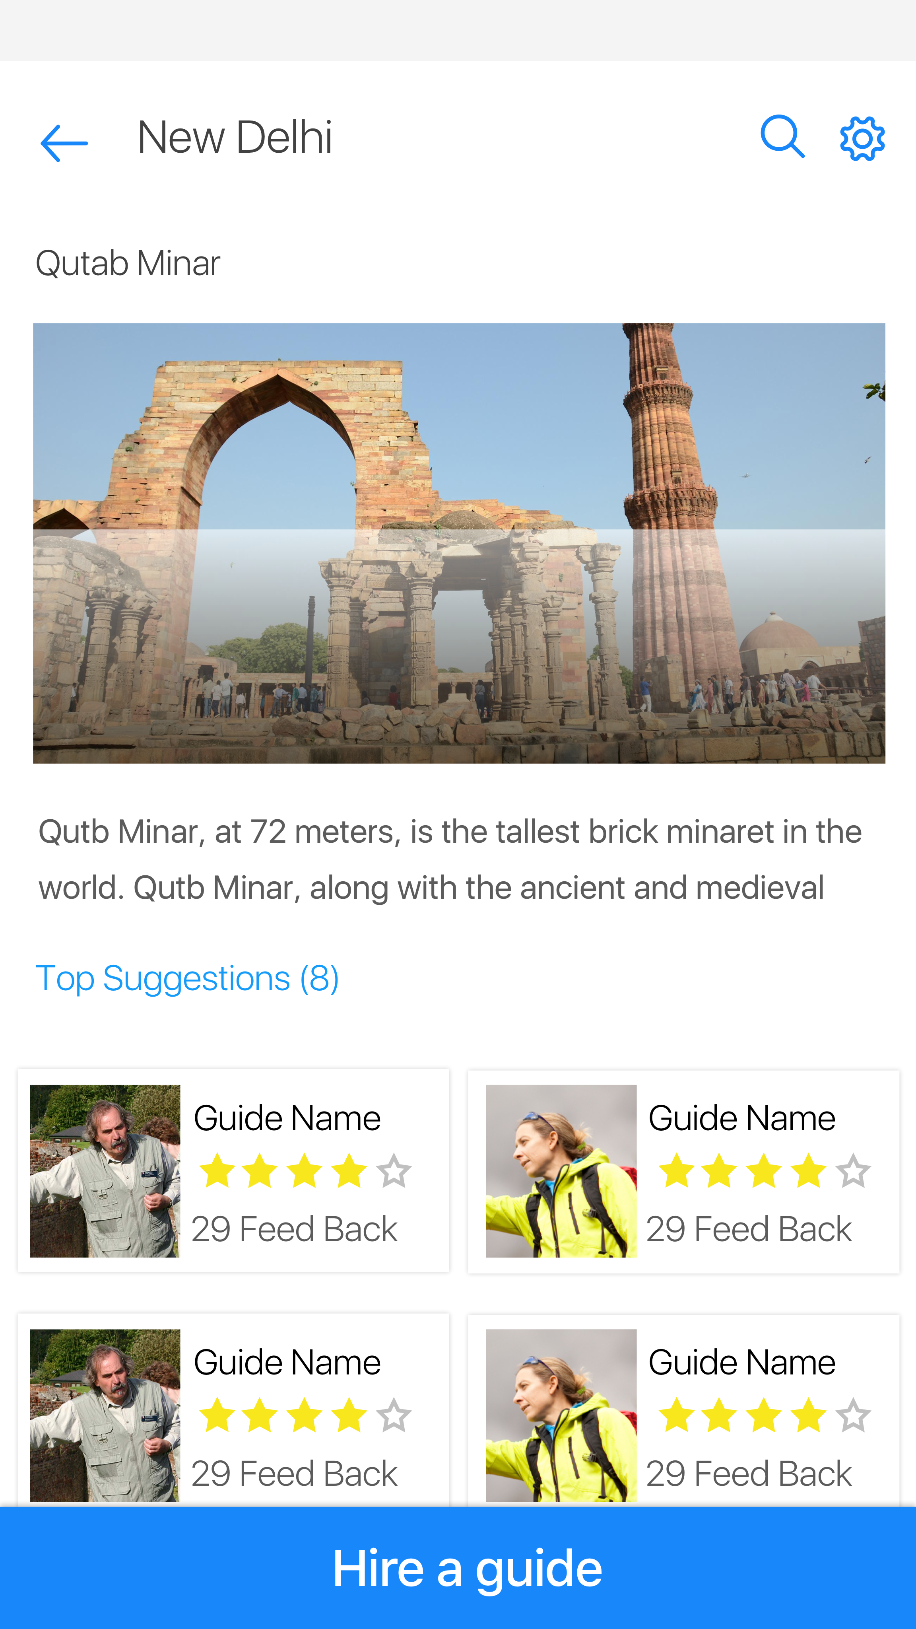
Explore more, go further and get more

Slide 13
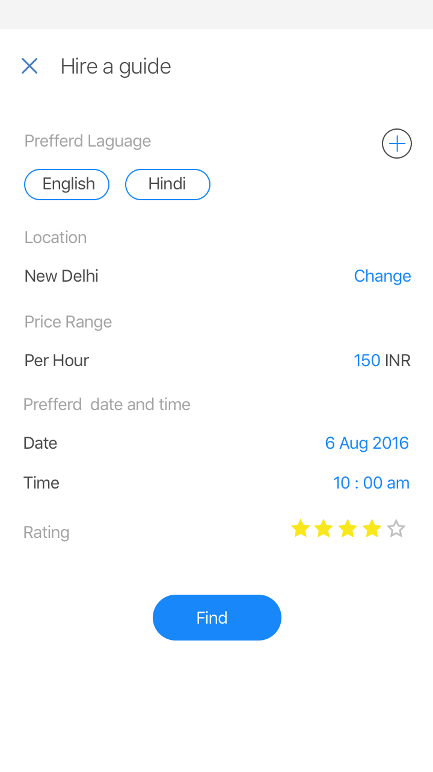
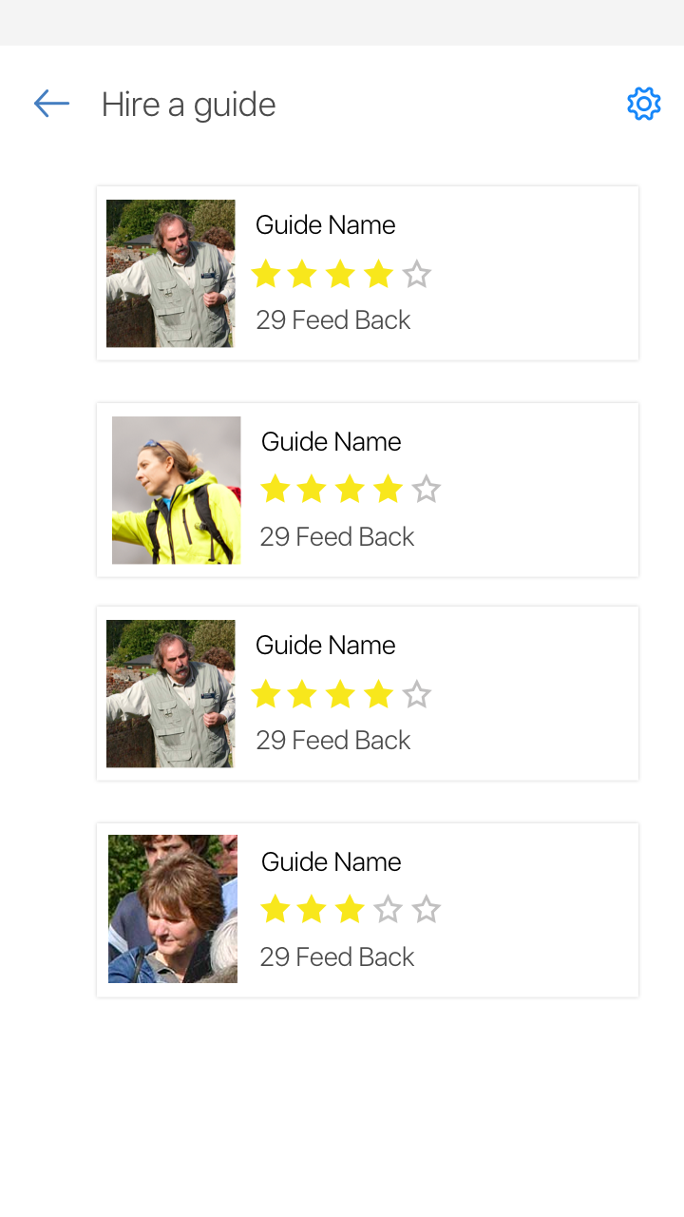
Get a guide as per your lingo and likings!

Slide 14
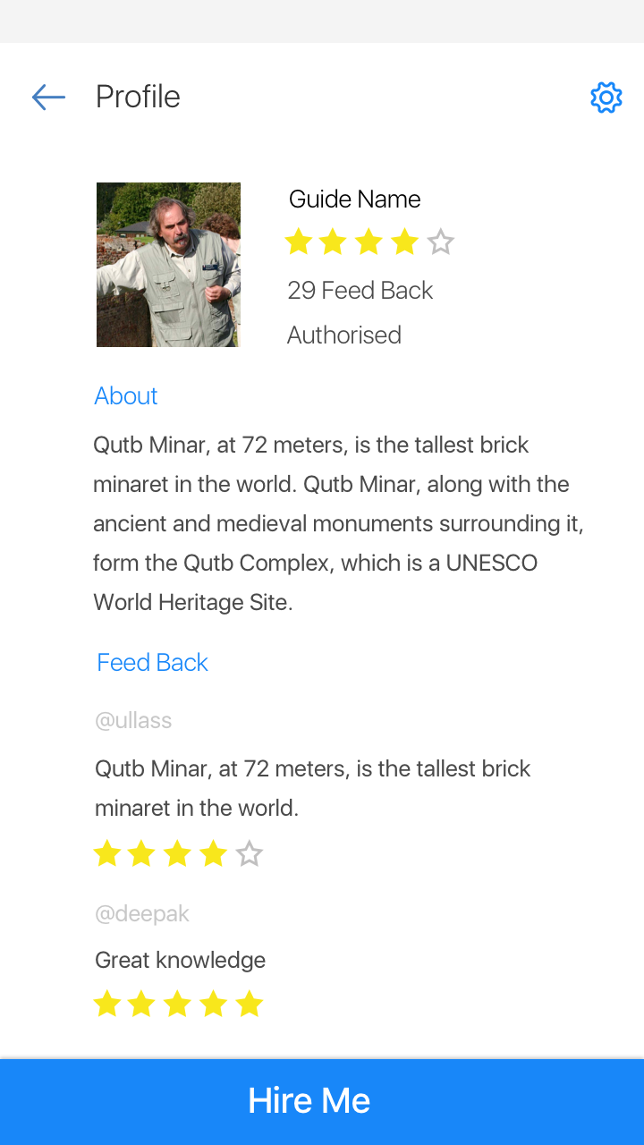
Know who’s guiding you!

Slide 15
Future Aspirations…
Integration with Cab Services and Hotel Services
Online/Offline/Phone support
Stand on the shoulders of the giants
Get patronage of Startup India campaign
Endorsement through Incredible India and Atithi Devo Bhava
Travel Buddy
Include Students, Historians, Volunteers as travel buddy
Weather information and places that are not open also timing and best time to visit a place.

Slide 16
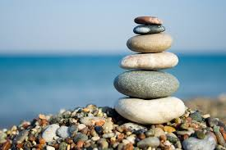
The Tech Stack
MongoDB
ExpressJS
ReactJS
NodeJS
Redux
Webpack
NancyFX
C#
Java
Android
TinyMCE
Docker

Slide 17


Slide 18
Hope you enjoyed the tour!
Thank you ☺

